Slide 1


ICST University Park
MediFlow+
Hospital & Healthcare
Management System
Intelligent, Connected and Patient-Centred Healthcare | UX & Interface Design | ICST University Park | S.Dharshika · IF.Ifra · JF.Ashra · AM.Rose Meha · MM.Manasir · MIM.Athnan

Slide 2




Healthcare
Challenges
Fragmented Records
Operational Inefficiency
Communication Gaps
Patient records are fragmented across systems, and appointment bookings remain manual — leading to errors, duplication, and poor continuity of care.
Long patient queues, poor bed and resource visibility, and inefficient scheduling create bottlenecks that compromise care delivery and patient satisfaction.
Weak inter-department communication, isolated data silos, and delayed access to clinical information hinder timely and informed decision-making.

Slide 3

Proposed
A single, unified, role-based web platform connecting patients, doctors, staff, administrators, and family caregivers — eliminating fragmented workflows and data silos through a secure, centralized system.
Solution:
MediFlow+
MediFlow+ delivers tailored dashboards and role-based permissions for every user type. Core features include appointment booking & scheduling, comprehensive medical records, bed and ward management, billing & payments, and real-time notifications — all integrated into one intelligent, patient-centred platform.

Slide 4



Project Objectives
MediFlow+ System Goals
Patient Experience
Clinical Workflow Efficiency
Operational Visibility
Improve patient experience and satisfaction through intuitive self-service tools, seamless appointment booking, and transparent queue and care updates.
Digitize and streamline clinical workflows by eliminating paper-based processes, reducing manual errors, and enabling faster, role-based task management.
Provide real-time operational visibility and enhance data integrity to support informed clinical decisions and efficient hospital resource management.

Slide 5


Stakeholders
Patient & Family
& User
Patients manage registration, appointment booking, queue tracking, and access to personal medical records. Family caregivers monitor patient status, request visitor passes, and receive care updates.
Roles
Doctor & Clinical Staff
MediFlow+ serves five distinct user groups, each with tailored dashboards, permissions, and workflows designed to meet their specific clinical and operational responsibilities within the hospital ecosystem.
Doctors conduct consultations, record diagnoses, and manage prescriptions and lab orders. Clinical staff oversee ward and laboratory operations, ensuring smooth patient care delivery.
Administrator
Administrators handle system oversight, user account management, billing supervision, bed and resource allocation, and access to the analytics dashboard for operational decision-making.

Slide 6

System Scope &
MediFlow+ encompasses a comprehensive suite of integrated modules spanning clinical, operational, and administrative functions — designed to unify every aspect of hospital management into a single, connected platform.
Core Modules
Appointments & Scheduling
Patient Profiles & Records
Online appointment booking with automated scheduling, slot management, conflict detection, and real-time calendar updates for patients and doctors.
Centralised, unified medical histories including diagnoses, prescriptions, lab results, and visit summaries — securely accessible by authorised roles.
Queue & Bed Management
Lab, Pharmacy & Billing
Real-time queue tracking for outpatient flow alongside bed, ward, and ICU availability monitoring to optimise resource allocation and reduce wait times.
End-to-end laboratory order management, pharmacy dispensing workflows, and integrated billing and payment processing with full audit trails.

Slide 7
Smart & AI Features
Intelligent Decision Support
MediFlow+ integrates AI-powered tools to enhance clinical decision-making, streamline triage, and optimise hospital operations. All AI features require clinical validation before use in critical care pathways. Additional capabilities include a Treatment Cost Estimator and Smart Navigation to guide users efficiently through the system.
01
02
AI-guided patient triage assists clinical staff in prioritising cases. The Emergency Assistant delivers rapid alerts and activates protocols to ensure swift response in critical situations.
Predictive analytics forecast resource needs, manage queue flow, and optimise bed and staff allocation. Reduces bottlenecks and improves real-time operational visibility across departments.
Symptom Checker & Emergency Assistant
Operational Predictions & Forecasting

Slide 8
Patient
Phase 1
Onboarding
Steps 1–3: Register or Login → Verify Account → Access Dashboard. Patient creates a secure account, completes identity verification, and gains access to their personalized MediFlow+ dashboard.
Journey
End-to-End Flow
Phase 2
Booking
Steps 4–6: Find a Doctor → Book Appointment → Track Queue. Patient searches for an available doctor by specialty, books a preferred time slot, and monitors real-time queue position before the consultation.
A 12-step end-to-end patient experience in MediFlow+, from initial registration through to follow-up care. Each phase is designed to be seamless, digitized, and patient-centred — ensuring continuity, clarity, and efficiency at every touchpoint across the healthcare journey.
Phase 3
Clinical Care
Steps 7–9: Attend Consultation → Complete Laboratory Orders → Obtain Medication. Doctor conducts the consultation, issues lab orders and prescriptions, and pharmacy dispenses medication through the integrated system.
Phase 4
Completion
Steps 10–12: Complete Billing & Payment → Receive Notifications → Attend Follow-Up. Patient settles the bill digitally, receives automated care notifications, and schedules a follow-up appointment to close the care cycle.

Slide 9

Role-Based
MediFlow+ delivers tailored dashboard experiences for every user role — ensuring each stakeholder sees exactly the information and tools they need to perform their responsibilities efficiently and effectively.
Dashboards
Patient Dashboard
Doctor Workspace
Appointment booking and history, medical records access, real-time queue tracking, test results, and prescription summaries in one unified view.
Manage consultations and patient notes, issue diagnoses and prescriptions, request lab orders, and review complete medical histories.
Admin Command Centre
Family-Care Dashboard
Full operational oversight including bed and ward management, staff administration, billing control, system analytics, and role-based user management.
Monitor patient status and care updates in real time, manage visitor pass requests, and stay informed about treatment progress and discharge planning.

Slide 10
Technical Architecture
System Layers & Technologies
MediFlow+ is built on a layered web architecture using PHP 8, MySQL, and Vanilla JavaScript. Each layer is independently responsible — from the browser UI to the database — ensuring modularity, security, and maintainability across all hospital management workflows.
01
02
HTML5, CSS3, Vanilla JavaScript for the responsive UI. PHP 8 Application & Services Layer handling business logic. Session Authentication & Role-Based Authorization controlling access.
PDO Data Access Layer for secure, abstracted database queries. MySQL relational database storing all clinical and operational records. Prepared statements enforcing SQL injection prevention.
Browser & Application Layer
Data Access & Security Layer

Slide 11


Database
Schema
Integrity
Design &
Primary & foreign keys enforced across all tables. ON DELETE constraints maintain referential integrity. NOT NULL, UNIQUE and CHECK constraints ensure data validity. Indexes applied for query performance optimization.
Schema
Core tables: Users, Patient Profiles, Doctors, Departments, Appointments, Queue Management, Beds & Wards. Extended: Medical Records, Prescriptions, Lab Orders, Bills, Payments, Pharmacy Orders, ICU Updates, Notifications, Audit Logs. Enforced with primary/foreign keys, ON DELETE constraints, NOT NULL, UNIQUE and CHECK rules.
Data
Security
PDO prepared statements prevent SQL injection across all data access layers. Parameterized queries used throughout the PHP 8 application. Audit logs track all critical data changes for compliance and traceability.

Slide 12



Security &
Reliability
Authentication & Access Control
Data Protection & Injection Defence
System Reliability & Monitoring
Password hashing with bcrypt, session timeout and regeneration policies, role-based access control, and two-factor authentication to ensure only authorised users access the system.
PDO prepared statements to prevent SQL injection, HTTPS/TLS encryption, environment secrets management, and audit logging to maintain data integrity and full traceability.
Automated backups, server monitoring, malware scanning, and penetration testing ensure continuous uptime, early threat detection, and resilient platform operations.

Slide 13
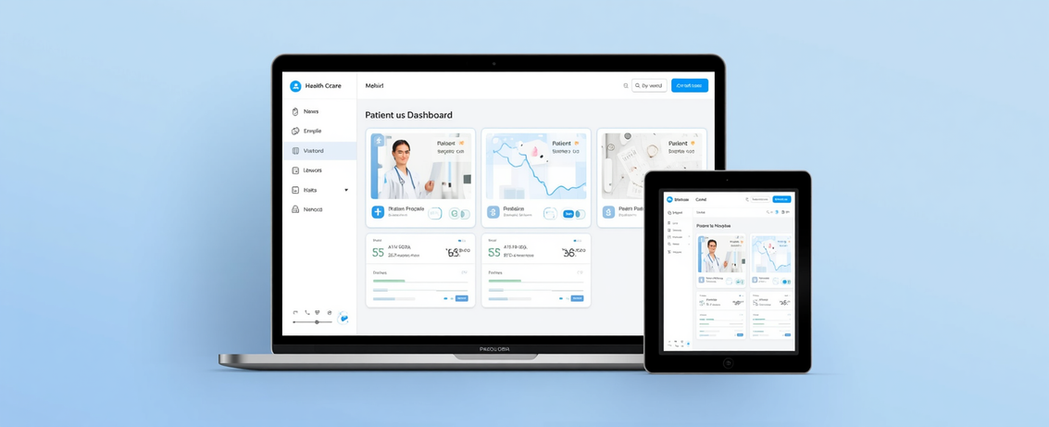
UI/UX
Consistent navigation and responsive layout
Design
Unified sidebar and header navigation across all dashboards. Fully responsive design supporting desktop, tablet, and mobile clinical workflows seamlessly.
Principles
Accessible clinical UI with visual dashboards
MediFlow+ is built around a clean, accessible clinical interface. Every screen prioritises clarity, consistency, and ease of use — ensuring all user roles can navigate confidently across devices and workflows.
Healthcare imagery and visual data panels enhance comprehension. Accessible colour contrasts and typography ensure usability for all clinical staff and patients.
Clear status indicators to guide users
Real-time status badges, queue indicators, and alert banners guide users through every step — from appointment booking to billing — reducing errors and confusion.

Slide 14

Testing &
MediFlow+ undergoes comprehensive multi-layer testing to ensure every module performs reliably, securely, and intuitively across all user roles and device types — backed by structured artefacts and traceability.
Validation
Functional & Integration
Security Testing
Business logic tested per module including appointments, billing, lab orders, and prescriptions. Integration testing validates end-to-end data flows across all system layers.
Authentication, session management, and SQL injection prevention tested rigorously. Role-based access control and PDO prepared statements verified against attack vectors.
Usability & Responsive
Artefacts & Traceability
Clinical workflows validated for usability across patient, doctor, and admin roles. Responsive testing conducted on desktop, tablet, and mobile environments.
SRS traceability matrix, user stories, test plans, detailed test cases, UI validations, database integrity checks, and route audits documented as validation artefacts.

Slide 15

Conclusion
Platform
Achievements
and Future
Unified patient journeys, clinical workflows, lab services, pharmacy, billing, bed and ward management, and real-time analytics. Core objectives fully met with digitized operations.
Outlook
MediFlow+ delivers an integrated, role-based hospital management platform built with PHP 8, MySQL, HTML5, CSS3, and Vanilla JS. It unifies patient journeys, clinical workflows, lab services, pharmacy, billing, bed management, and analytics — meeting all core objectives of digitized operations and real-time visibility.
Future
Roadmap
SMTP/SMS notifications, payment gateway integration, cloud deployment, disaster recovery, AI clinical validation, HIPAA/GDPR compliance, and HL7/FHIR interoperability.

Slide 16



MediFlow+
Thank You
Questions & Discussion
MediFlow+ | Healthcare Management System
Intelligent, Connected and Patient-Centred Healthcare
mediflow@university.ac.uk
www.mediflow-hms.ac.uk

